Slide 1
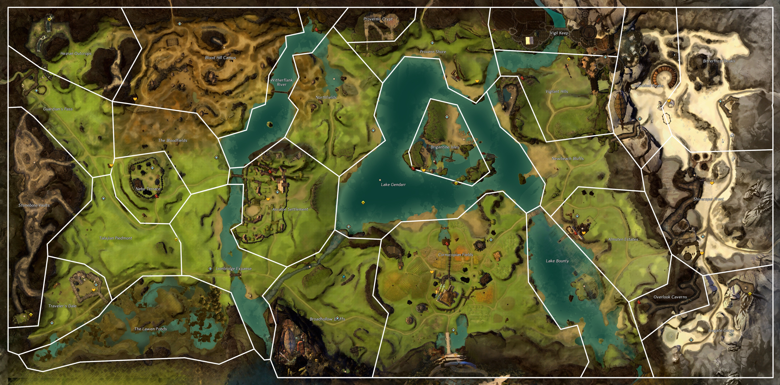
9
16
16
11
8
12
15
10
10
13
7
4
4
14
6
3
2
5
1
1

Slide 2
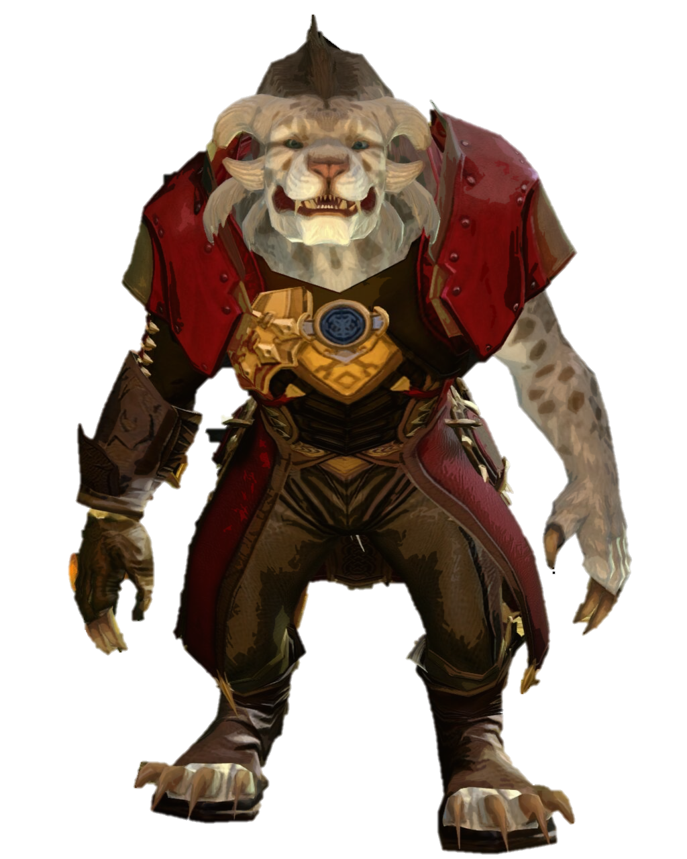
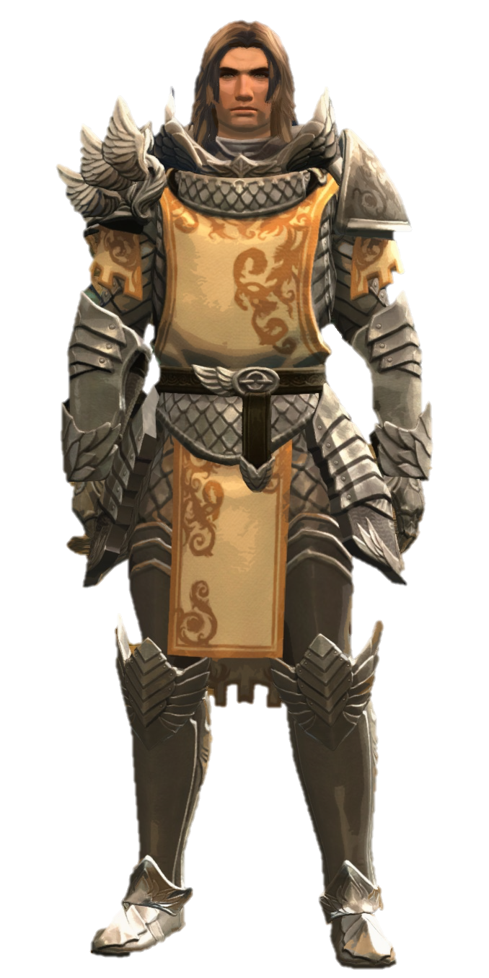

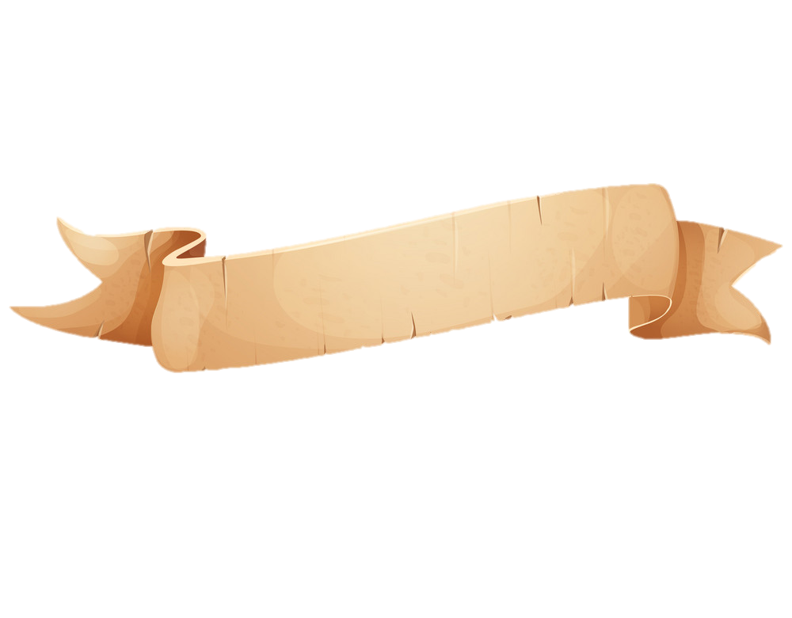
Welcome back to the world of the waking! Glad you helped us at the garrison with the centaur attack. If you’re looking to stretch your legs, can you go with Faren and check on fields? Follow the road and head over to the windmill.
1
Tybalt
Logan

Slide 3
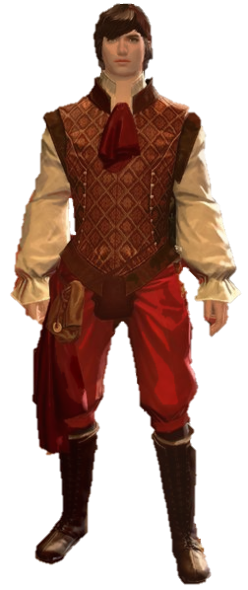
Well, if it isn’t the new “hero”. I hope that knock to your head didn’t do any permanent damage. Logan asked me to come help out but…I’ve been distracted watching that beautiful woman. She is in quite the “Diah-lema”, but I didn’t bring my working clothes. Help her out and come find me by the river.
Somehow its always bandits and this close to home. Let’s check on Flannum and make sure they haven’t done any “dam-age”. Alright, alright, I’ll stop.
You check the north side, and I’ll check the south. Meet you at the western shore.
3
2

Slide 4
Slave collars and cages, by the nine… Jennah...I mean the queen, won’t be happy to hear this. I’m also concerned about these centaur attacks. Let’s see if we can push them back and buy us some room to think. Reclaim the plateau and meet me by the trading post.
I hope you showed them no mercy. Lexi just finished telling me about how difficult it’s been to get supplies. Shall we help clear the road? We need to check on the Bar Curtis Ranch, past the Altar Brook bridge.
8
9

Slide 5
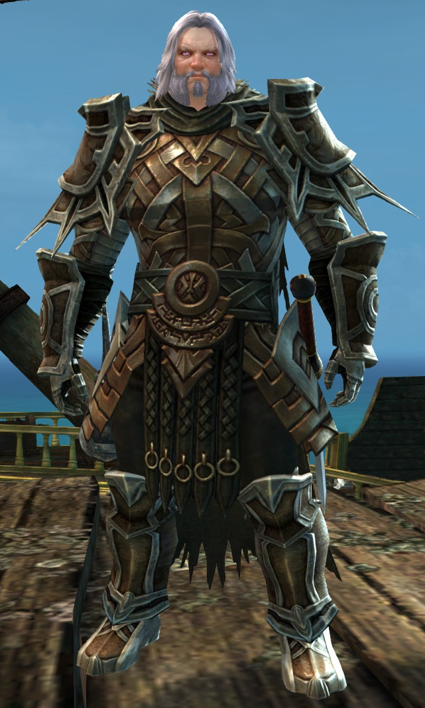

Slide 6
